Slide 1



2
Unit 2 Section A
The humanities: Out of date?
FOREIGN LANGUAGE TEACHING AND RESEARCH PRESS
AIR FORCE ENGINEERING UNIVERSITY
Notes:
1

Slide 2
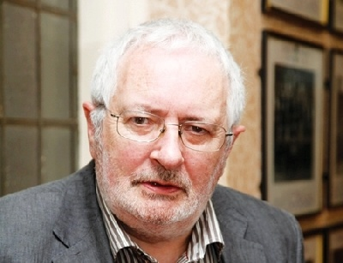
2
2
UNIT
The humanities should constitute the core of any university worth the name.
— Terry Eagleton
(British literary critic, writer)
Ideally, we all want an integrated life. Your goal should be to find a way to do what you love, and make your education support that.
— Bruce B. Janz
(American philosopher)
Notes:
2

Slide 3

^{Section A}
2
2
College — The ladder to success?
UNIT
The humanities: Out of date?
To talk about significance of the humanities
Objectives
To further understand the text
To apply the phrases and patterns
To master the essay writing skill

Slide 4






The humanities: Out of date?
Section A
Contents
Warming-up activities
Text study
Language application
Summary

Slide 5



The humanities: Out of date?
Section A
Warming-up activities
Lead-in
Pre-reading activities
Cultural background

Slide 6

Lead-in
Short answer questions
1. How do you think of your current major? If you were given a second chance to choose your major, what would you select and why?
If I were given a second chance to choose my major, I would choose …/ I think being a … is …
accounting, computer science, psychology,
civil engineering, philosophy, medical technology …
popular, interesting, enjoyable, promising, practical, meaningful, beneficial, well-paid …

Slide 7
Lead-in
Short answer questions
2. What liberal arts / humanities courses do you learn in college? Do you think they are necessary for your education?
I learn Chinese, English, philosophy, psychology, history … in college. I think they are an essential part of the college education and benefit me a lot.
• gain more insight in life and society
• better understand and predict human behavior
• realize different interpretations of life and history
• understand the past which has created the present
• be aware of cultural and religious differences

Slide 8
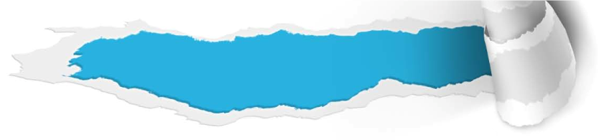


Pre-reading activities
Listen and talk
Listen to a talk about a native English speaker’s learning experience in his high school years. Choose the best answer to each of the following questions.
1. What did the speaker compare his high school education to?
A Technical school.
B Modern arts college.
C Liberal arts college.

Slide 9
Pre-reading activities
Listen and talk
2. What was the most beneficial part for the speaker to take history classes?
A He learned more about history.
B He learned how to write a good essay.
C He gained more cultural awareness.
3. How did the speaker benefit through learning the Spanish language?
A He became a more competent communicator.
B He satisfied the requirements of a foreign language.
C He learned how to speak Spanish fluently.

Slide 10
Pre-reading activities
Listen and talk
4. What else did the speaker learn in addition to the things he learned from history and Spanish classes?
A He learned how to read assigned textbooks.
B He learned how to get meaning from texts.
C He learned how to go over every single word in reading.
For what purpose did the teacher give students red pens and their own compositions?
A Ask them to learn how to improve communication skills.
B Ask them to learn how to memorize facts and formulas.
C Ask them to learn how to evaluate their own writing critically.

Slide 11
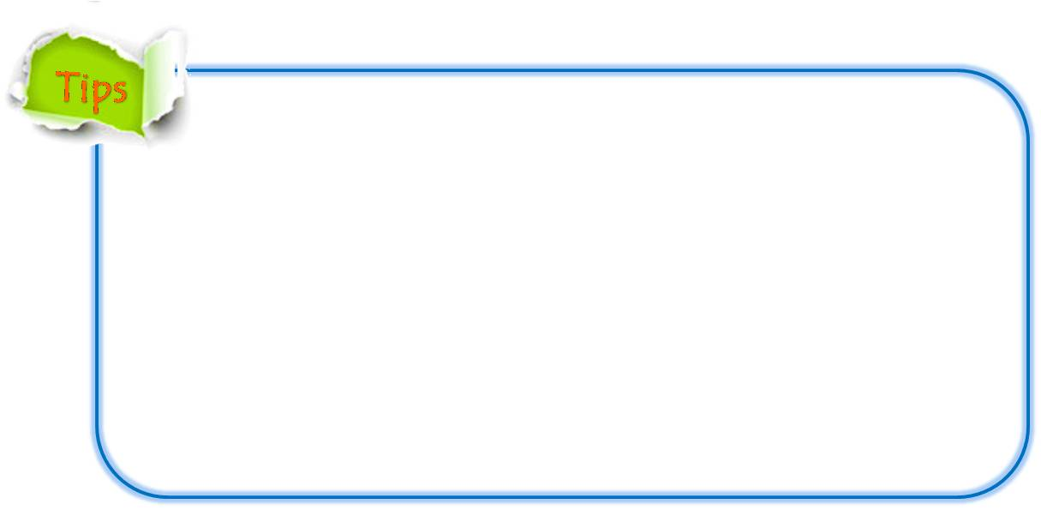
Pre-reading activities
Listen and talk
Listen to the talk again and answer the two questions
1. Do you think your high school education was very much like attending a liberal arts college? Why or why not?
Yes, because we took many liberal arts courses in addition to science courses.
No, because our high school laid more emphasis on sciences and we often competed with other schools in sciences such as math and physics.

Slide 12
Pre-reading activities
Listen and talk
Listen to the talk again and answer the two questions
2. What are the most important skills you learned in high school?
Learned how to communicate with my teachers and classmates.
Improved my critical thinking and analytical skills.
Boosted my confidence in dealing with difficulties and challenges.

Slide 13

Pre-reading activities
Compound dictation
Listen to a short passage concerning the function of the university and fill in the missing information.
The justification for a university is that it preserves the connection between knowledge and the zest of life, by 1 the young and the old in the imaginative consideration of learning. The university imparts information, but it imparts it imaginatively. At least, this is the 2 which it should perform for society. A university which fails in this respect has no reason for 3 .
uniting
function
existence
To be continued

Slide 14
Pre-reading activities
Compound dictation
Listen to a short passage concerning the function of the university and fill in the missing information.
This atmosphere of excitement, arising from imaginative consideration, transforms knowledge. A fact is no longer a bare fact: it is _____4______ all its possibilities. It is no longer a burden on the memory: it is energising as the poet of our dreams, and as the architect of our purposes. Imagination is not to be ______5_____ the facts: it is a way of illuminating the facts.
invested with
divoced from
To be continued

Slide 15
Pre-reading activities
Compound dictation
Listen to a short passage concerning the function of the university and fill in the missing information.
It works by drawing the general principles which ___6____ the facts, as they exist, and then by an intellectual survey of alternative possibilities which are ________7_____ those principles. It enables men to construct an intellectual vision of a new world, and it preserves the zest of life by the suggestion of satisfying purposes. Youth is imaginative, and if the imagination be ____8_____ by discipline this energy of imagination can in great measure be preserved through life.
apply to
consistent with
strengthened
To be continued

Slide 16
Pre-reading activities
Compound dictation
Listen to a short passage concerning the function of the university and fill in the missing information.
The tragedy of the world is that those who are ____9 ____ have but slight experience, and those who are experienced have feeble imaginations. Fools act on imagination without knowledge; pedants act on knowledge without imagination. The task of a university is to _____10_____ imagination and experience.
imaginative
weld together

Slide 17


Cultural background
The humanities
Questions Previewing
1. What are the humanities?
Tips
2. Why are the humanities important?
Tips

Slide 18

Cultural background
Humanities
1. What are the humanities?
The humanities are a group of academic disciplines that study the human condition, using methods that are primarily analytical, critical, or speculative. Therefore, they are distinguished from the approaches of the natural sciences. The humanities, called social sciences, include history, anthropology, communication studies, cultural studies, law, language, literature, philosophy, religion, music and theater, etc.

Slide 19

Cultural background
Humanities
2. Why are the humanities important?
Through exploration of the humanities, students learn how to think creatively and critically, to reason, and to ask questions. Because these skills allow students to gain new insights into everything from poetry and paintings to business models and politics, humanistic subjects have been at the heart of a liberal arts education. Today, humanistic knowledge continues to provide the ideal foundation for exploring and understanding the human experience.

Slide 20


The humanities: Out of date?
Section A
Text study
Main idea & structure
Language focus
Critical thinking

Slide 21

Main idea & structure
Main ideas of the parts
Tips
This essay argues against the current tendency that college students move away from ___________________ to __________________ such as accounting to help them easily ______________. (Paras.1-2)
studying the humanities
learning “hard skills”
land a future job

Slide 22
Main idea & structure
Main ideas of the parts
This is a trend that is likely to persist and even accelerate. (Para. 2)
Tips
Students have defected from … and toward …
trend
College education is more and more seen as … rather than …
Notes:
22

Slide 23
Main idea & structure
Main ideas of the parts
What role did the humanities play in the past and what role does it play now in students’ university life? (Para. 3)
Tips
dominant pillars
bit roles
What is the “unconscious mind” according to Sigmund Freud? (Para. 4)
Tips
The inner forces that drive some people to greatness and others to self-destruction
Notes:
23

Slide 24
Main idea & structure
Main ideas of the parts
What forms the basis of study of the humanities according to the author? (Para. 5)
Tips
the fertile body of work about the mysterious inner drive by historians, architects, authors, philosophers and artists from the ancient times
Notes:
24

Slide 25

Main idea & structure
Main ideas of the parts
Part I — (Paras. 1- __)
5
Part I provides the background information of the argument. By moving away from the humanities and taking some “hard-skill” courses instead, students think it would improve _______________________. Because of the economic downturn, this trend is likely to ______________________. However, the humanities play a significant role in people’s lives and can’t be ignored.
their chance of finding a job
persist and even accelerate

Slide 26
Main idea & structure
Main ideas of the parts
What are the advantages of studying the humanities according to the author? (Paras. 6-8)
Tips
1. To improves our ability to read and write (Para.6);
2. To makes us familiar with the language of emotion and the creative process;
3. To invests us with great insight and self-awareness;
4. To releasing our creative energy and talent in a positive and constructive manner (Para.7);
5. To provide a large scope of possibilities;
6. To prepare us for many different careers and jobs we can undertake (Para.8).
Notes:
26

Slide 27

Main idea & structure
Main ideas of the parts
What is increasingly seen as the ideal in the establishment of a career? (Para. 9)
Tips
a pairing of technical knowledge and inner insight

Slide 28
Main idea & structure
Main ideas of the parts
Part II — Paras. __ - __
6
9
Part II presents the author’s argument to stand up for the true value of the humanities: studying the humanities can improve our ability to read and write, ____________ great insight and self-awareness, thereby releasing our creative energy and talent, and provide the __________________ that are widely open to us. It also suggests that inner insight, combined with technical knowledge, is ______ for the establishment of a good career.
invest us with
scope of possibilities
ideal

Slide 29
Main idea & structure
Main ideas of the parts
Paras. 6-9
well-
rounded human beings
In summary, the humanities help to create ____ __________________ with insight and understanding of the passions, hopes and dreams common to all humanity. The humanities, the ancient timeless___________________, teach us to see differently and _________________– which is as useful and relevant in our modern age as it has always been. Doesn’t it make sense to spend some time ______________ the humanities, our outstanding and remarkable treasure of knowledge? Who knows how famous YOU might become!
reservoir of knowledge
broaden our horizons
in the company of

Slide 30
Main idea & structure
Main ideas of the parts
Part III — (Para. 10)
Part III summaries the main ideas stated in the argument: ______________________
__________________________________
__________________________________
__________________________________.
The humanities help to create well-rounded human beings with inner insight and understanding of the passions, hopes and dreams common to all humanity

Slide 31
Main idea & structure
Main idea of the text
moving away from the humanities and taking “hard-skill” courses
The trend of students __________________
__________________________________ is likely to persist and even acclerate. However, studying the humanities brings a lot of ______ to people’s lives and helps to create well-rounded human beings. The humanities are as ________________ in the modern age as they have always been.
benefits
useful and relevant

Slide 32
Main idea & structure
Structure of the text
Background information
Students are moving away from the humanities to “hard skills” to improve their future chance of
landing a job. (Paras. 1-2)
As labor
markets continue to shrink, the humanities will
continue to be in bad shape. (Para. 3)
It speculates on the inner power of human beings that
has driven them to either greatness or destruction, thus forming the basis of study of the humanities. (Paras. 4-5)

Slide 33
Main idea & structure
Structure of the text
Background information
Author’s argument
Studying the humanities can improve our ability to read and write and to understand complex ideas. (Para. 6)
Studying the humanities can invest us with great insight and self-awareness.
(Para. 7)
The humanities provide the scope of
possibilities that are widely open to us. (Para. 8)
Inner insight,
combined with technical knowledge, is ideal for the
establishment of a good career. (Para. 9)

Slide 34
Main idea & structure
Structure of the text
Background information
Author’s argument
The humanities help to create well-rounded human beings with inner insight and understanding of the passions, hopes and dreams common to all humanity. (Para. 10)

Slide 35
Main idea & structure
Structure of the text
Background information
Author’s argument
Conclusion

Slide 36
Main idea & structure
Summary of the text
Retell the text according to the following tips.
(Part I) When the job market worsens, many students calculate ... Probably, the humanities will continue …. Once …, the humanities now …
To be continued

Slide 37
Main idea & structure
Summary of the text
Retell the text according to the following tips.
(Part II) Here, please allow me to … that the humanities add to people’s lives. Studying the humanities improves… Most importantly, studying the humanities invests us with …, thereby… Perhaps the best argument in favor of the humanities is… In fact, increasingly… is seen as the ideal in…
To be continued

Slide 38
Main idea & structure
Summary of the text
Retell the text according to the following tips.
(Part III) In summary, the humanities help to create …, teach us to … and… It makes sense to …, our outstanding and remarkable …

Slide 39
Language focus
Practical phrases
Practical Phrases | Specific Meanings
1. major in | 主修（某一）科目
2. in succession | 连续发生
3. be bound to | 肯定会，注定
4. stand up for | 支持，维护
5. speculate about | 推测，猜测
6. invest sb. with sth. | 赋予(某人/某物)以某种性质
7. be liable to | 可能/易于做某事

Slide 40

Language focus
Practical phrases
主修（某一）科目
短语逆译
major in
短语应用
对具有电脑知识人才的高需求是我选择在大学主修计算机科学的原因。
意群提示
(the high demand for / computer science)
The high demand for persons with knowledge about computers is why I chose to major in computer science at the university.

Slide 41
Language focus
Practical phrases
连续发生；接连发生
短语逆译
in succession
短语应用
她是一个颇有成就的运动员，连续四次获得冠军。
意群提示
(an accomplished athlete / championship)
She is an accomplished athlete and won the championship four times in succession.

Slide 42
Language focus
Practical phrases
肯定会
短语逆译
be bound to
短语应用
只要我们尽力而为，不管结果是输是赢，我们必定可以从这次经历中有所收获。
意群提示
(try our best / gain something positive)
As long as we try our best we are bound to gain something positive from the experience whether we win or lose.

Slide 43
Language focus
Practical phrases
支持；维护
短语逆译
stand up for
短语应用
老板在会议上支持了我，使我免受了一些尴尬。
意群提示
(spare / embarrasment)
The boss stood up for me at the meeting, sparing me some embarrassment.

Slide 44
Language focus
Practical phrases
猜测；推测
短语逆译
speculate about/on
短语应用
要推测工会和资方之间的谈判结果，还为时过早。
意群提示
(the worker’s union / the company’s leadership)
It is too early to speculate about the outcome of the negotiations between the worker’s union and the company’s leadership.

Slide 45
Language focus
Practical phrases
赋予（某人或某物）以（某种性质）
短语逆译
invest sb/sth with sth.
短语应用
学习人文学科赋予你批判思维的能力，为你提供无限的机遇。
意群提示
(critical thinking / the scope of many opportunities)
Studying humanities invests you with critical thinking and provides you with the scope of many opportunities.

Slide 46
Language focus
Practical phrases
可能/易于做某事
短语逆译
be liable to do sth.
短语应用
如果现在你不能勇于面对自己的错误，那么将来有可能会重蹈覆辙。
意群提示
(face up to / repeat)
If you can’t face up to your mistake now, you are liable to repeat it in the future.

Slide 47
Language focus
Practical phrases
与……一起
短语逆译
in company with
短语应用
与石油市场一起，美元在1986年经历了一个艰难的时期。
意群提示
(go through / a bad phase)
In company with the oil market, the US dollar went through a bad phase in 1986.

Slide 48
Language focus
Functional patterns
Functional Patterns | Functions & Usages
1.Sth. is/are more and more seen as … rather than … | 用于表达“人们对某一事物的看法的变化”。
2. Once + N., sth. now … | 用于表达“今昔对比”。
3. If sb. only do sth. / If sb. do sth. alone, it’s likely that … / sb. are liable to … | 用于表达“如果只做……可能出现的后果”。
Notes:
48

Slide 49
Language focus
Functional patterns
原句译文
大学教育越来越被看成是改善经济而不是提升人类自身的手段。
逆译练习
… a college education is more and more seen as a means for economic betterment rather than a means for human betterment. (Line 3, Para.2)
句型提炼
Notes:
49

Slide 50

Language focus
Functional patterns
句型提炼
Sth. is/are more and more seen as … rather than …
应用提示
用于表达“人们对某一事物的看法的变化”。
句型应用
Notes:
50

Slide 51
Language focus
Functional patterns
典型例句
大学的真正价值越来越被看作是发展学生的个人特质及社会技能，而非是大学课程本身。
意群提示
(developing one’s identity / curriculum)
The true value of college is more and more seen as developing the students’ identity and practicing social skills rather than learning the college curriculum.

Slide 52
Language focus
Functional patterns
原句译文
人文学科曾是大学生活的重要支柱，而今在学生们的大学游中却只是一个小点缀。
逆译练习
Once the dominant pillars of university life, the humanities now play bit roles when students take their college tours. (Line 4, Para.3)
句型提炼
Notes:
52

Slide 53
Language focus
Functional patterns
句型提炼
Once + N., sth. now …
应用提示
用于表达“今昔对比”。
句型应用
Notes:
53

Slide 54
Language focus
Functional patterns
典型例句
这个村子曾经是一个风景秀美的地方，现在却因为地震变成一片废墟。
意群提示
(stunning scenic beauty / lie in ruins)
Once a place with stunning scenic beauty, the village now lay in ruins because of the earthquake.

Slide 55
Language focus
Functional patterns
原句译文
1.如果我们仅学习数学，我们很可能只能申请数学家之类的工作。
2. ……如果我们单学人文，可能会失去很多机会。
逆译练习
If we study only mathematics, it’s likely we will be a candidate only for jobs as a mathematician. (Line 9, Para.8)
2. … if we study the humanities alone, we are liable to miss many opportunities. (Line 1, Para.9)
句型提炼
Notes:
55

Slide 56
Language focus
Functional patterns
句型提炼
If sb. only do sth. / If sb. do sth. alone, it’s likely that …/ sb. are liable to …
应用提示
用于表达“如果只做……可能出现的后果”。
句型应用
Notes:
56

Slide 57
Language focus
Functional patterns
典型例句
如果我们只是关注眼前利益而不考虑长远发展，那么很有可能我们会得不偿失。
意群提示
(the immediate needs and interests / lose / gain)
译文2：If we focus on the immediate needs and interests alone and fail to take the future development into consideration, we are liable to lose more than what we gain.
译文1：If we only focus on the immediate needs and interests and fail to take the future development into consideration, it’s very likely that we will lose more than what we gain.

Slide 58


Language focus
Language appreciation
Language appreciation
a. Most importantly, studying the humanities invests us with great insight and self-awareness, thereby releasing our creative energy and talent in a positive and constructive manner. (Line 4, Para. 7)
最重要的是，学习人文学科使我们具有伟大的洞察力和自我意识，从而以积极和建设性的方式来发挥我们的创造力和才艺。

Slide 59
Language focus
Language appreciation
总之，人文学科帮助造就全面发展的人，这些人具有洞察力，并理解全人类共有的激情、希望和理想。
b. In summary, the humanities help to create well-rounded human beings with insight and understanding of the passions, hopes and dreams common to all humanity. (Line 1, Para.10)

Slide 60
Language focus
Language appreciation
人文学科，这个古老、永恒的知识储蓄库，教我们如何以不同的方式看待事物，同时也拓宽我们的视野。在现代社会中，人文学科一如既往地同生活息息相关，也发挥着重要作用。
c. The humanities, the ancient timeless reservoir of knowledge, teach us to see differently and broaden our horizons – which is as useful and relevant in our modern age as it has always been. (Line 2, Para.10)

Slide 61

Critical thinking
Theme exploration
1 What are the main factors that affect students’ decision on choosing their majors?
Tips
2 Why are there more science majors than liberal arts majors in college today?
Tips
3 Should schools give more support to the study of the humanities? Why or why not?
Tips

Slide 62

Critical thinking
Theme exploration
1 What are the main factors that affect students’ decision on choosing their majors?
personal interest
• special talents
• future job prospects
• financial status
• family advice
• friends influence
• social environment

Slide 63
Critical thinking
Theme exploration
2. Why are there more science majors than liberal arts majors in college today?
better job opportunities
more practical skills
Highly-paid jobs

Slide 64
Critical thinking
Theme exploration
3. Should schools give more support to the study of the humanities? Why or why not?
Yes, it invests students with great insight.
• Yes, it helps students be better-rounded.
• Yes, it provides students with flexibility to change their careers.
• No, it doesn’t satisfy students’ needs for their future careers.
• No, colleges are experiencing deep budget cuts and need to prioritize their financial resources.
• No, the society needs more skills, not literatures.

Slide 65
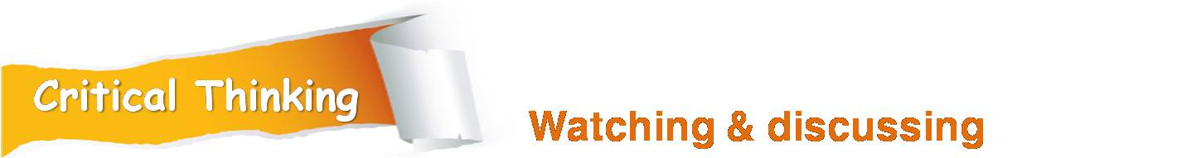


Critical thinking
Watch a video clip about the liberal arts education and discuss some questions.
What are the benefits of having the liberal arts education?
Tips
Video Watching

Slide 66

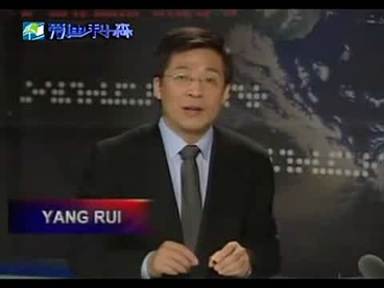
Critical thinking
Back

Slide 67

Critical thinking
What are the benefits of having the liberal arts education?
Prepare students broadly;
Teach students to think creatively and critically;
Equip students with a sound structure of knowledge;
Help gain more insight in life and society;
Better understand and predict human behavior;
Understand the past which has created the present;
Be aware of cultural and religious differences;
…

Slide 68
Critical thinking
Culture exploration
How are the Chinese educational institutions different from that of the US as is mentioned in the video?
In the US, liberal arts education lay the groundwork for the tertiary education. Students are expected to cultivate their intellelctual capacities in general before they choose their majors in the third or fourth year of the college.
While in many Chinese institutions of higher learning, natural sciences are seperated from the social sciences and humanities. It’s quite likely that Chinese engineers or scientists do not have a sound knowledge structure despite their academic excellence.

Slide 69

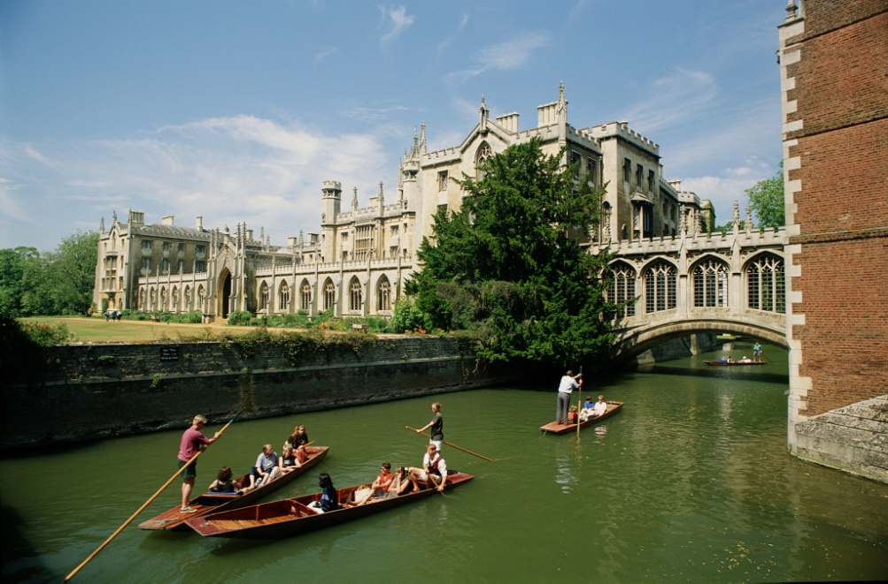
The humanities: Out of date?
Section A
Language application
Writing devices
Essay writing
Paragraph translation

Slide 70
Writing devices
How to write an advantage/disadvantage essay
Generally speaking, the outline of writing an advantage / disadvantage essay falls in one of these three formats: 1) advantages and disadvantages; 2) advantages only; 3) disadvantages only. When you write such an essay, remember that you are giving information, a method that is called exposition or expository writing.
to be continued

Slide 71
Writing devices
How to write an advantage/disadvantage essay
Begin your essay by introducing your topic and explaining that you are exploring the advantages or disadvantages of the topic. Mention in your thesis statement the advantages or disadvantages you will discuss in the essay. Use transitions to make your ideas flow smoothly. The following transitional words are very common when writing an advantage / disadvantage essay:
to be continued

Slide 72
Writing devices
Transitional words
Firstly, …
In other words, …
This means that …
It is also …
Another advantage is that …
Finally, …
In conclusion, …
To sum up, …
to be continued

Slide 73
Writing devices
How to write an advantage/disadvantage essay
Close your essay with the summary of the advantages and / or disadvantages. Even though you are not persuading your readers when you write this type of writing, you are required to add your opinion at the end as your final comment on the topic. For example, if you’re talking about the advantages of taking courses of the humanities, you may say in your conclusion:
to be continued

Slide 74
Writing devices
How to write an advantage/disadvantage essay
To sum up, by taking courses in the humanities, students gain more analytical ability, acquire more critical thinking skills, and deal with things more rationally. Students should be aware of the significance of taking these courses.
to be continued

Slide 75
Writing devices
How to write an advantage/disadvantage essay
You can always choose a position when you write about an advantage / disadvantage essay. For instance, you don’t have to talk about both advantages and disadvantages of taking natural science courses. Instead, you can only focus on one, the advantages of taking these courses or the disadvantages of doing that.
to be continued

Slide 76

Writing devices
Now, examine how this method of writing is reflected in Text A, specifically Paragraphs 4-10.

Slide 77
Writing devices
The true value that the humanities add to people’s lives
The inner drive that moves people either to greatness or to selfdestruction was captured by historians and many others in various forms. Their fertile work from ancient times helps us understand the aspirations of human beings, and it also forms the very foundation of civilization and the basis of the study of the humanities. (Paras. 4-5)
Introduction
to be continued

Slide 78
Writing devices
The true value that the humanities add to people’s lives
Studying the humanities improves our ability to read and understand complex ideas and write a clear and elegant analysis of those ideas. (Para. 6)
Body: Advantages of studying the humanities
Studying the humanities invests us with great insight and selfawareness, thereby releasing our creative energy and talent in a positive and constructive manner. (Para. 7)
Studying the humanities provides us with a wide scope of possibilities and prepare us for our future career. (Para. 8)
Nowadays, a pairing of technical knowledge and inner insight is the ideal for the establishment of a career. (Para. 9)
to be continued

Slide 79
Writing devices
The true value that the humanities add to people’s lives
The humanities help to create human beings with insight and understanding of the passions, hopes and dreams common to all humanity. The humanities will never be out of date. They are as useful and relevant in our modern age as they have always been. (Para. 10)
Conclusion
to be continued

Slide 80
Writing devices
How to write an advantage/disadvantage essay
From what is listed in the chart, we can see that writing an essay about the advantages or disadvantages of an issue requires supporting points. If your essay focuses on advantages of studying the humanities, then several advantages should be provided to support your point.
to be continued

Slide 81

Writing devices
Read the sample essay and see how the advantages are introduced.

Slide 82
Writing devices
Topic:
The advantages of taking natural science courses
Introduction:
Thesis statement: Taking natural science courses benefits students in several ways but two stand out.
to be continued

Slide 83
Writing devices
Body:
Advantage 1: Be involved in more active learning
Advantage 2: Be more motivated to learn
Conclusion:
Being more active and more motivated are the two major advantages for students who take natural science courses.
to be continued

Slide 84
Writing devices
Sample:
At our school, all students are required to take a minimum of six courses in the natural sciences. Students majoring in the humanities often have to struggle to get through these demanding courses, so it has been suggested that the requirements be modified. In my opinion, taking natural science courses benefits students in several ways but two stand out.
to be continued

Slide 85
Writing devices
Sample:
First, students will be involved in more active learning if they take natural science courses. Obviously, learning natural sciences enables students to question and solve problems without expecting someone to give them specific answers. In this way, they develop their confidence in their own ability. Also, figuring out the process rather than just following directions results in a solution unique to the learners, which will surely help them to go further.
to be continued

Slide 86
Writing devices
Sample:
Another important advantage is that students taking natural science courses can be more motivated. That is because natural science courses are more meaningful and practical. Taking natural science courses not only prepares students for their future career but also enables them to make use of their own personal concepts as a basis for understanding. Therefore, the value of studying science is clearer. Simply because students are able to see principles at work, they are more motivated to grasp the newly discovered ideas.
to be continued

Slide 87
Writing devices
Sample:
In brief, being more active and more motivated are the two major advantages for students who take natural science courses. Moreover, by connecting the new information to the real world, students can
acquire the skills that are highly valued by their future employers.

Slide 88

Writing practice
Directions: Write an essay of no less than 150 words on one of the following topics. One topic has an outline that you can follow.

Slide 89
Topic:
Advantages of taking physical education (P.E.) courses
Introduction:
Thesis statement: Taking P.E. courses can be advantageous to all college students.
Body:
Advantage 1: Learn valuable communication and teamwork skills
Advantage 2: Handle heavy coursework more effectively
Conclusion:
Taking a P.E. course at college can benefit students in developing useful social skills as well as better coping skills for their stress at school.

Slide 90
More topics:
• Advantages of taking liberal arts courses
• Disadvantages of majoring in liberal arts

Slide 91
You may adopt the following expressions.
boost one’s prospects of …
be bound to
dominant pillar / play bit roles
stand up for
invest us with…
in a positive and constructive manner
make breakthroughs on many barriers
be liable/likely to
well-rounded human beings
in the company of

Slide 92
Paragraph translation
Translate a paragraph based on a summary of the text by using the expressions from the text.

Slide 93
Paragraph translation
continue their slide in succession
未来几年里，人文学科可能会继续其长期低迷的态势。这里我想为人文学科的真实价值进行维护和宣传。首先，学习人文学科会提高我们的阅读和写作能力。更重要的是，学习人文学科使我们具有伟大的洞察力和自我意识，从而以积极和建设性的方式来施展我们的才能。
stand up for
promote
invest us with
release our creative energy and talent
To be continued

Slide 94
Paragraph translation
也许支持人文学科的最好论点是，它为我们从事许多不同的职业做准备。学习人文学科的有名人士可以列举一长串。总之，人文学，这个古老、永恒的知识储蓄库，教我们以不同的方式看待事物，拓宽我们的视野，帮助造就全面发展的人。在现代社会中，人文学一如既往地发挥着重要作用。
The best argument in favor of …
make a long list
reservoir of knowledge
well-rounded
as … as it has always been
Samples

Slide 95
Paragraph translation
Over the next few years, the humanities will probably continue their slide in succession. Here, I would like to stand up for and promote the true value of the humanities. First of all, studying the humanities improves our abilities to read and write. More importantly, studying the humanities invests us with great insight and self-awareness, thereby releasing our creative energy and talent in a positive and constructive manner.
To be continued

Slide 96
Paragraph translation
Perhaps the best argument in favor of the humanities is it prepares us for many different careers. Famous people who studied the humanities make a long list. In summary, the humanities, the ancient timeless reservoir of knowledge, teach us to see differently and broaden our horizons, and help to create well-rounded human beings. In the modern age the humanities is as important as it has always been.

Slide 97

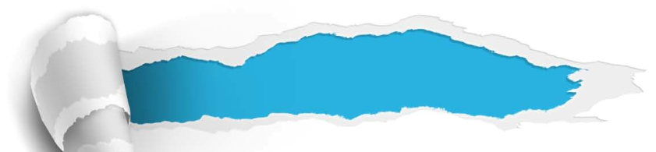
The humanities: Out of date?
Section A
Summary
Revision of
the useful expressions
Thematic study
Revision of
the functional patterns

Slide 98
Revision of
the useful expressions
Language points—Useful expressions
1 主修
2 改善前景
3 持续低迷
4 注定/肯定
5 强大支柱
6 小小点缀
7 支持；维护
8 猜测；推测
9 引起某人的想象
10 大量的作品
major in
boost one’s prospects of …
continue their slide in succession
be bound to
dominant pillar
play bit roles
stand up for
speculate about/on
capture one’s imagination
the fertile body of work

Slide 99
Revision of
the useful expressions
Language points—Useful expressions
11赋予我们以……
12 以积极的、建设性的方式
13可以列举一长串
14突破许多障碍
15可能
16全面发展的人
17永恒的知识储蓄库
18 ……是明智的
19 与……为伴
invest us with…
in a positive and constructive manner
make a long list
make breakthroughs on many barriers
be liable/likely to
well-rounded human beings
the timeless reservoir of knowledge
It makes sense to do …
in the company of

Slide 100
Revision of
the functional patterns
Language points—Useful patterns
Functions & Usages | Sentence Patterns
表示“人们对某一事物的看法的变化”。
表示“今昔对比”。
表示 “如果只做……可能出现的后果”。
sth. is/are more and more seen as … rather than …
once + N., sth. now …
If sb. only do sth. / If sb. do sth. alone, it’s likely that … / sb. are liable to …
Notes:
上面挤，下面空

Slide 101

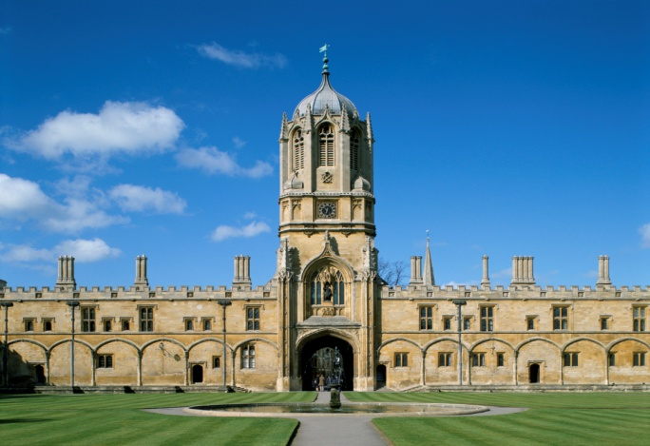
The humanities: Out of date?
Section A
The end

